Slide 1


Android App Remote Control Joystick
Liav Trabelsy
Hadas Babayov

Slide 2

MVVM architecture

Slide 3
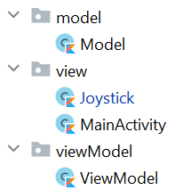
MVVM in our application

Slide 4
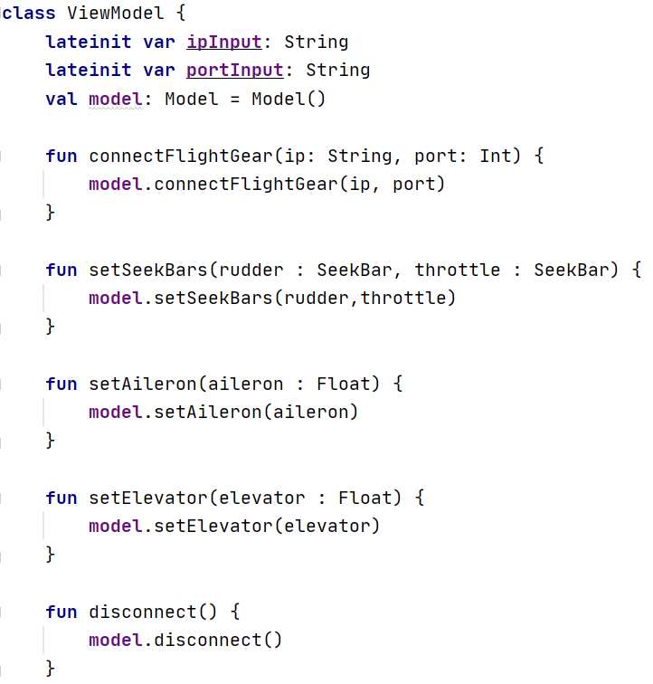
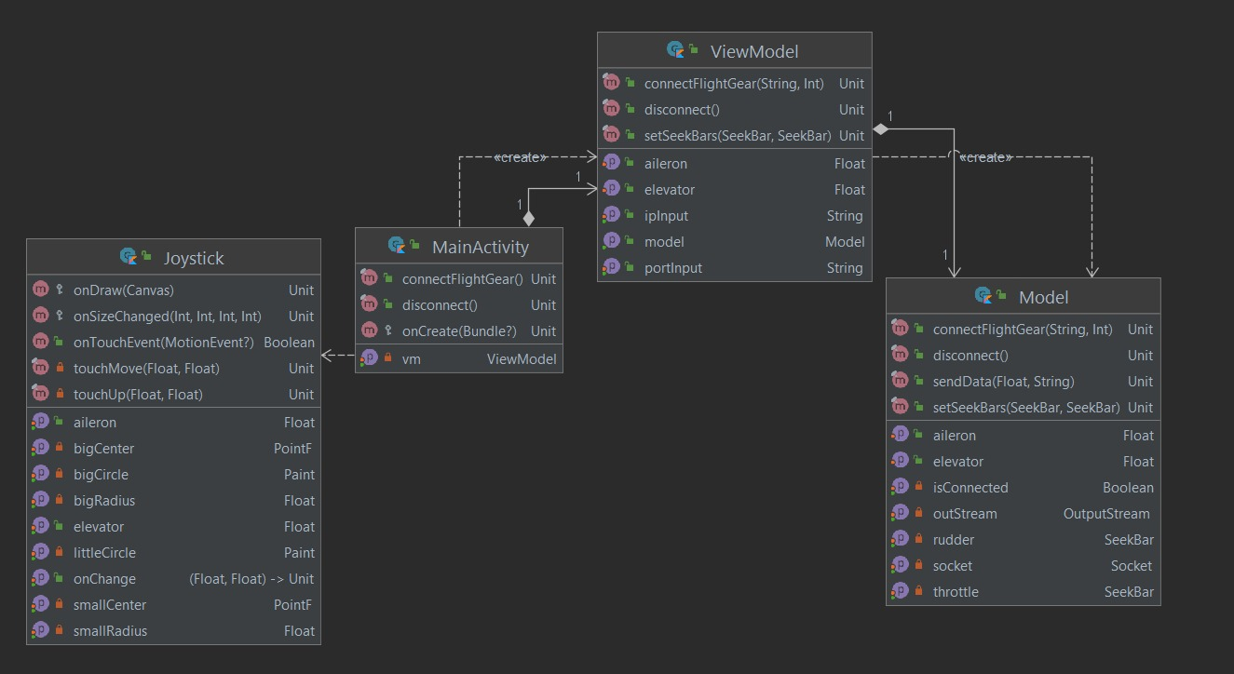

Slide 5
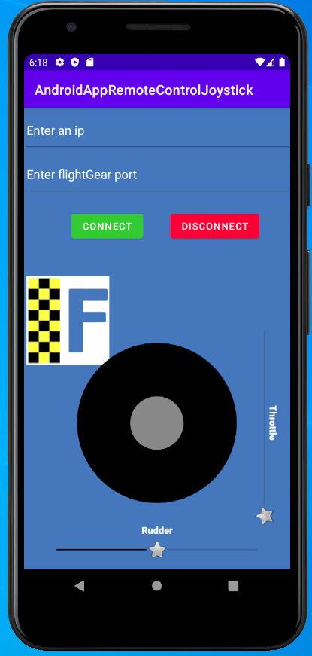
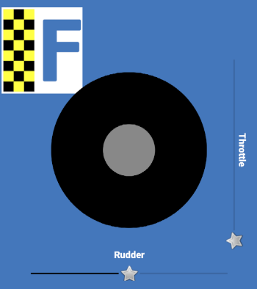
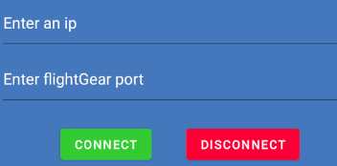
The application screen

Slide 6
Thanks for watching ☺

